Slide 1
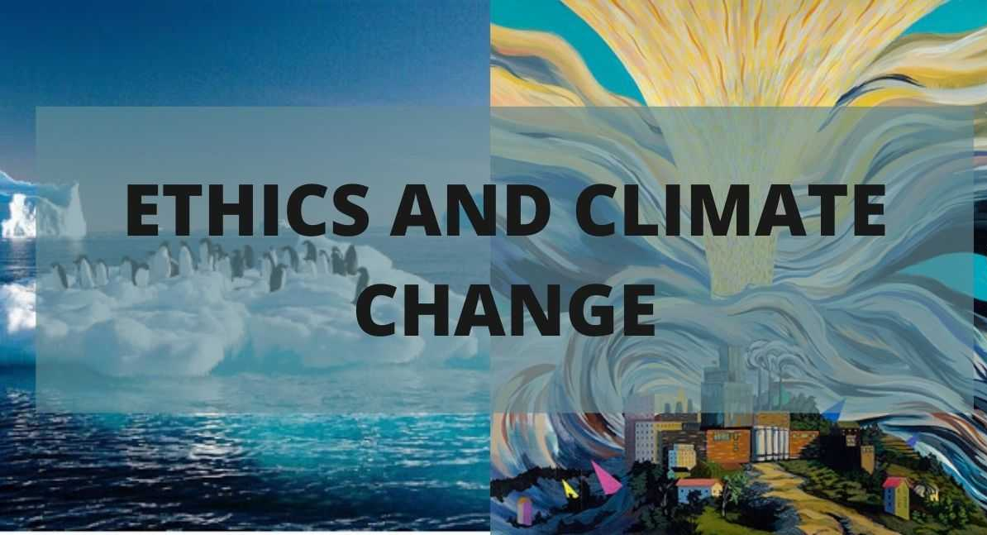

Slide 2
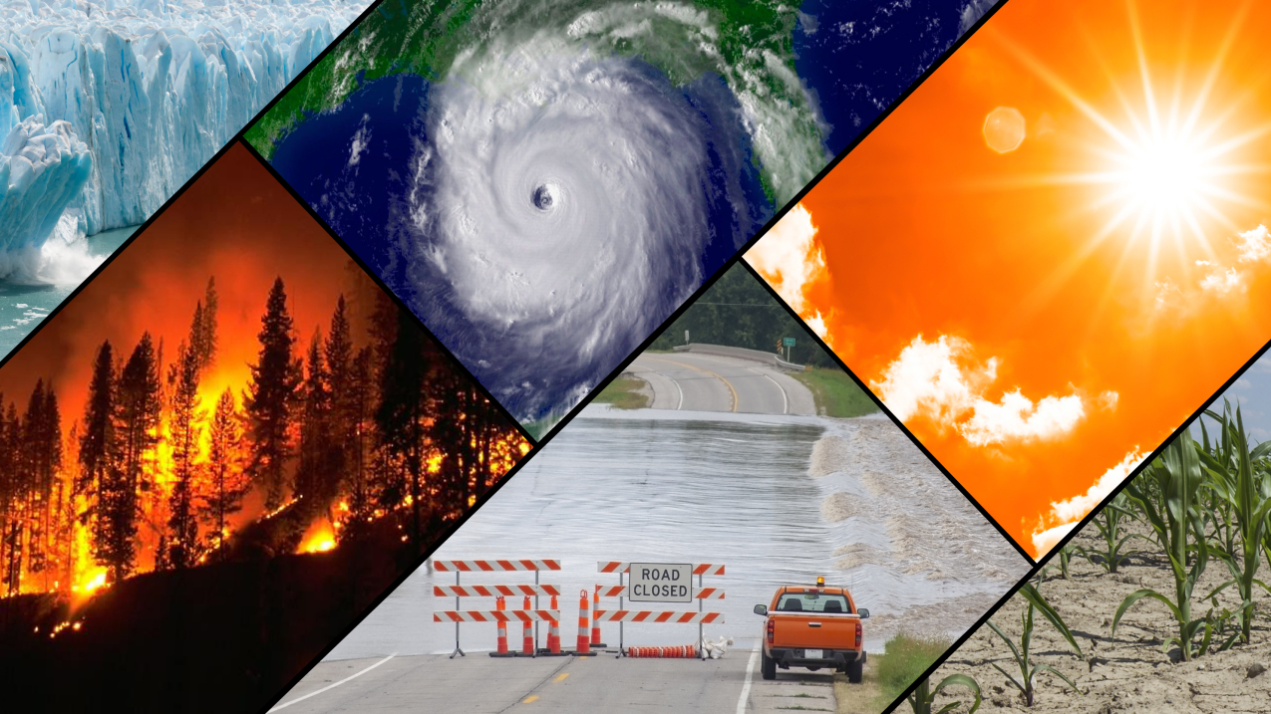
Climate change refers to long-term alterations in temperature, precipitation, and other atmospheric conditions on Earth, primarily driven by human activities such as the burning of fossil fuels, deforestation, and industrial processes.

Slide 3
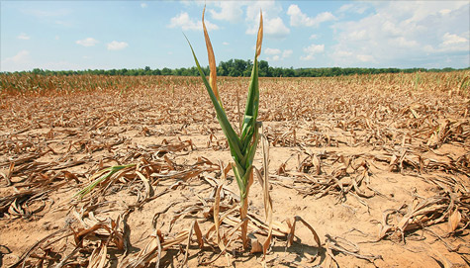
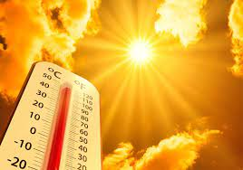
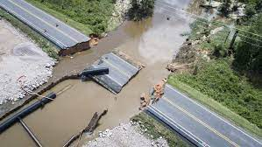
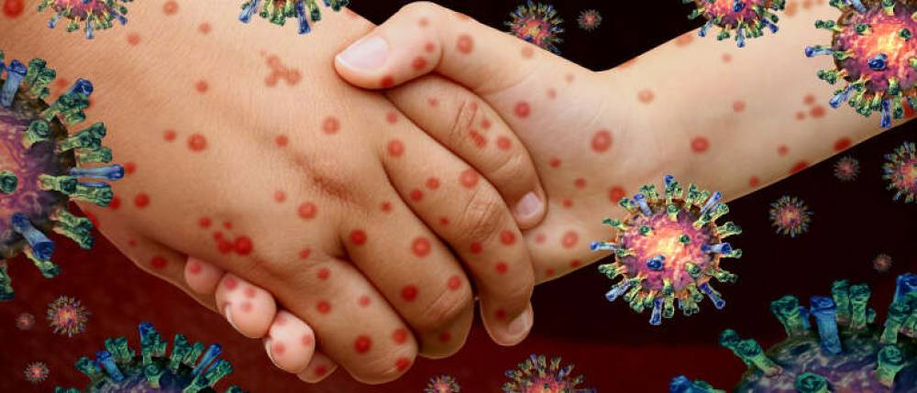
1.Environmental Impact
2. Social Impact
3. Economic Impact
4. Health Impact

Slide 4
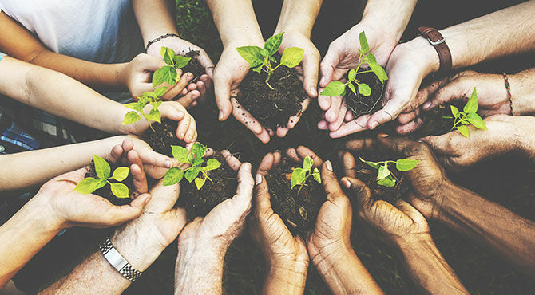
Ethical Imperative
The moral responsibility to address climate change extends to individuals, communities, and nations alike, grounded in the recognition of our interconnectedness and the shared obligation to safeguard the planet for current and future generations.
Individual Responsibility
Community Responsibility
National Responsibility

Slide 5
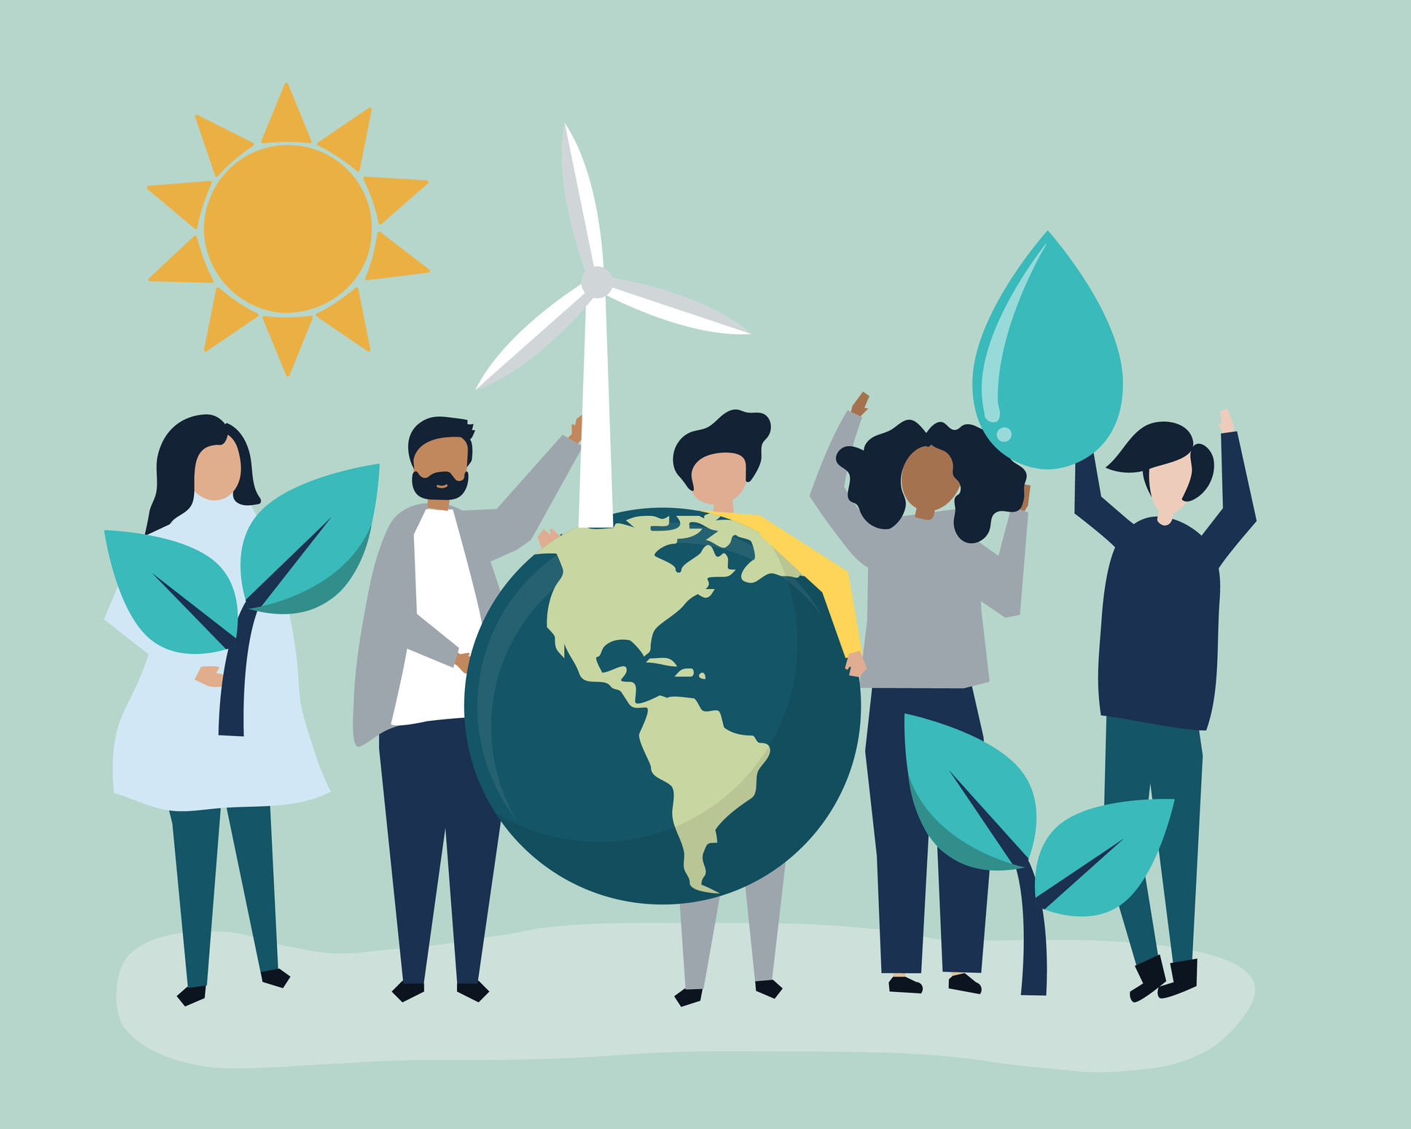
Environmental Justice
Climate change disproportionately affects vulnerable communities, exacerbating existing social, economic, and environmental inequalities.
Geographical Vulnerability
Economic Disparities
Social Inequities
Ethical Implications
Equitable Solutions

Slide 6
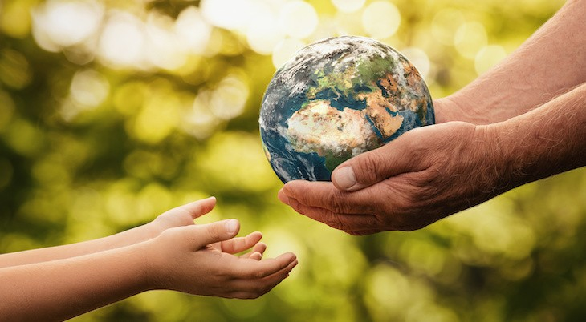
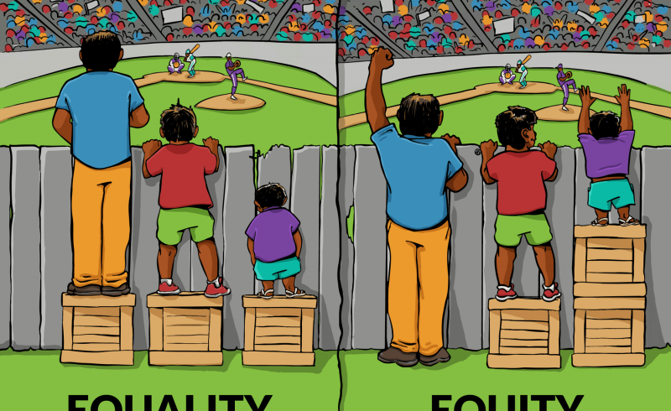
Inter-Generational Equity
The ethical dimension of ensuring that future generations have the same or better opportunities to enjoy a healthy environment is encapsulated in the concept of "intergenerational equity."

Slide 7
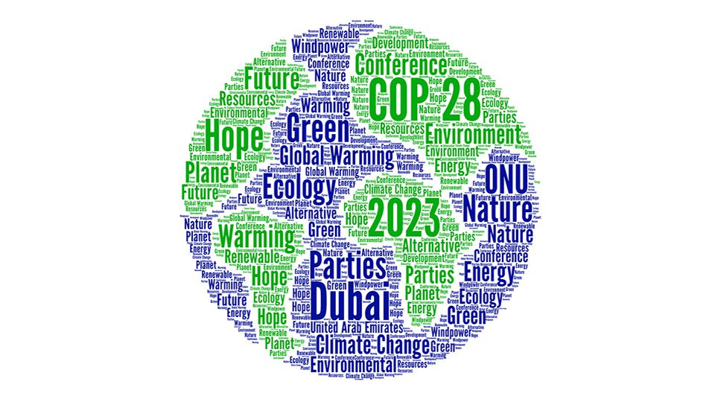
Global Cooperation
International collaboration is crucial in addressing climate change, as the impacts of global warming transcend borders, and collective efforts are required to mitigate its effects.
Resource Distribution
Technology Transfer
Support for Developing Nations
Climate Justice
Solidarity and Shared Responsibility

Slide 8
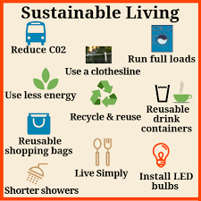
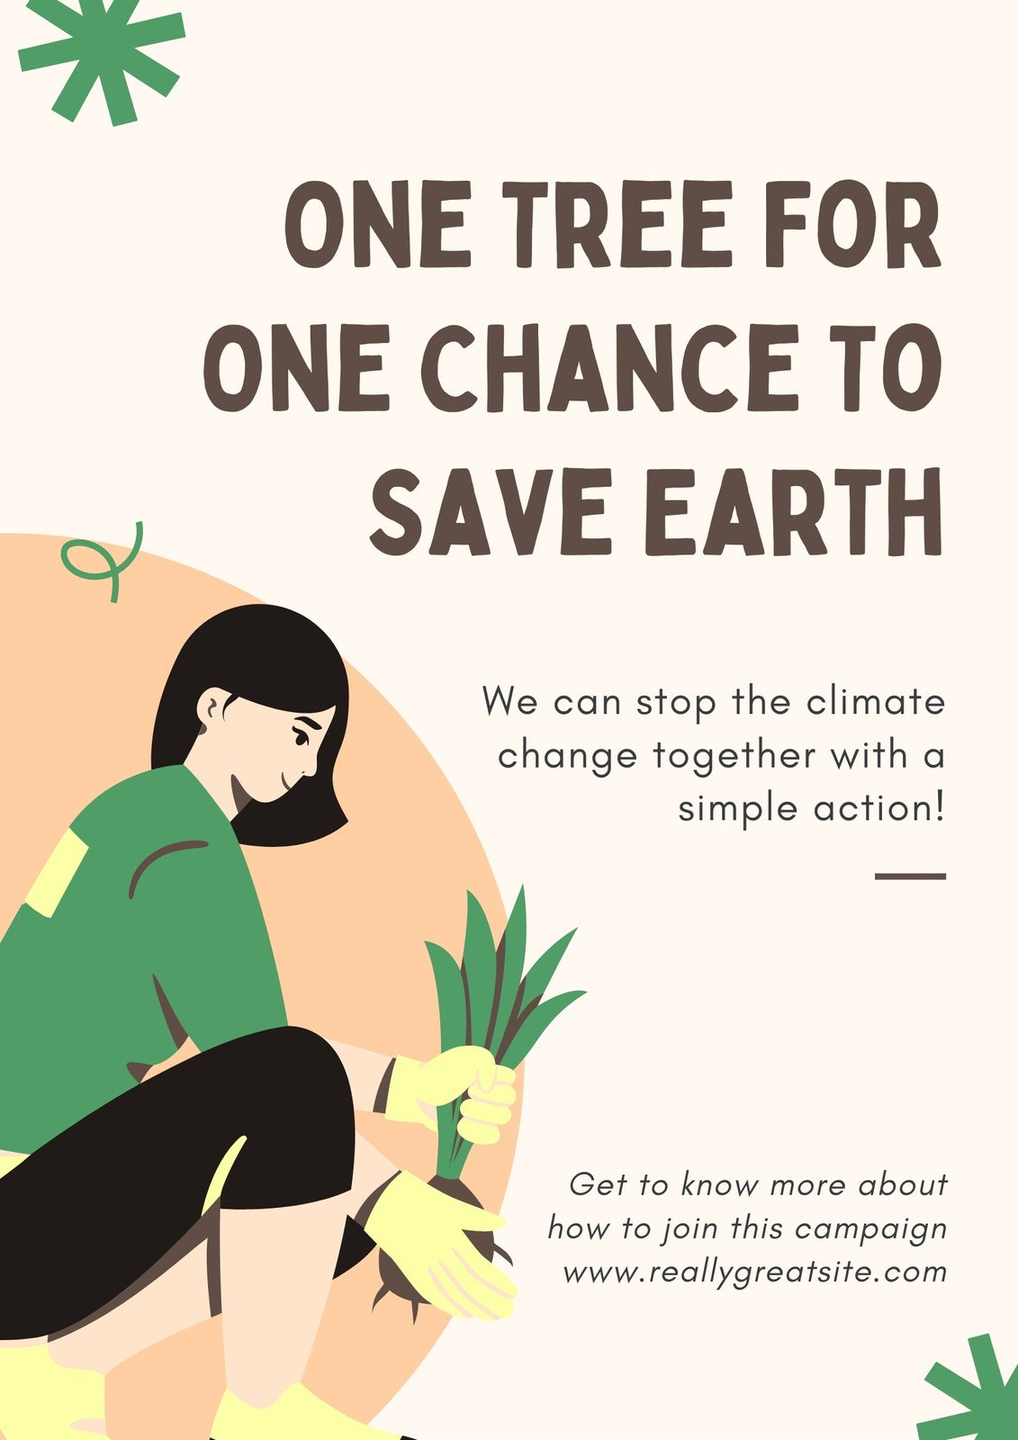
Individual Actions
Encouraging ethical decision-making at the individual level is a crucial aspect of addressing global challenges like climate change.
Sustainable Lifestyle Choices
Responsible Consumption
Educating and Advocating
Collective Impact

Slide 9
Climate Change 2023: Synthesis Report
The Climate Change 2023: Synthesis Report, a culmination of years of scientific effort by the Intergovernmental Panel on Climate Change (IPCC), underscores human responsibility for the 1.1°C global temperature rise over 200 years, causing destructive weather events. Released ahead of COP28 and the Global Stocktake, the report asserts that limiting warming to 1.5°C is still possible with immediate, inclusive action. Emphasizing climate justice, it urges global cooperation in sharing best practices, technology, policy measures, and finance to transition away from carbon-intensive practices. Prioritizing climate resilience in low-income and marginalized communities is highlighted for maximum well-being gains. The report stresses the urgency of comprehensive efforts at all levels to achieve climate goals and prevent further environmental degradation.

Slide 10
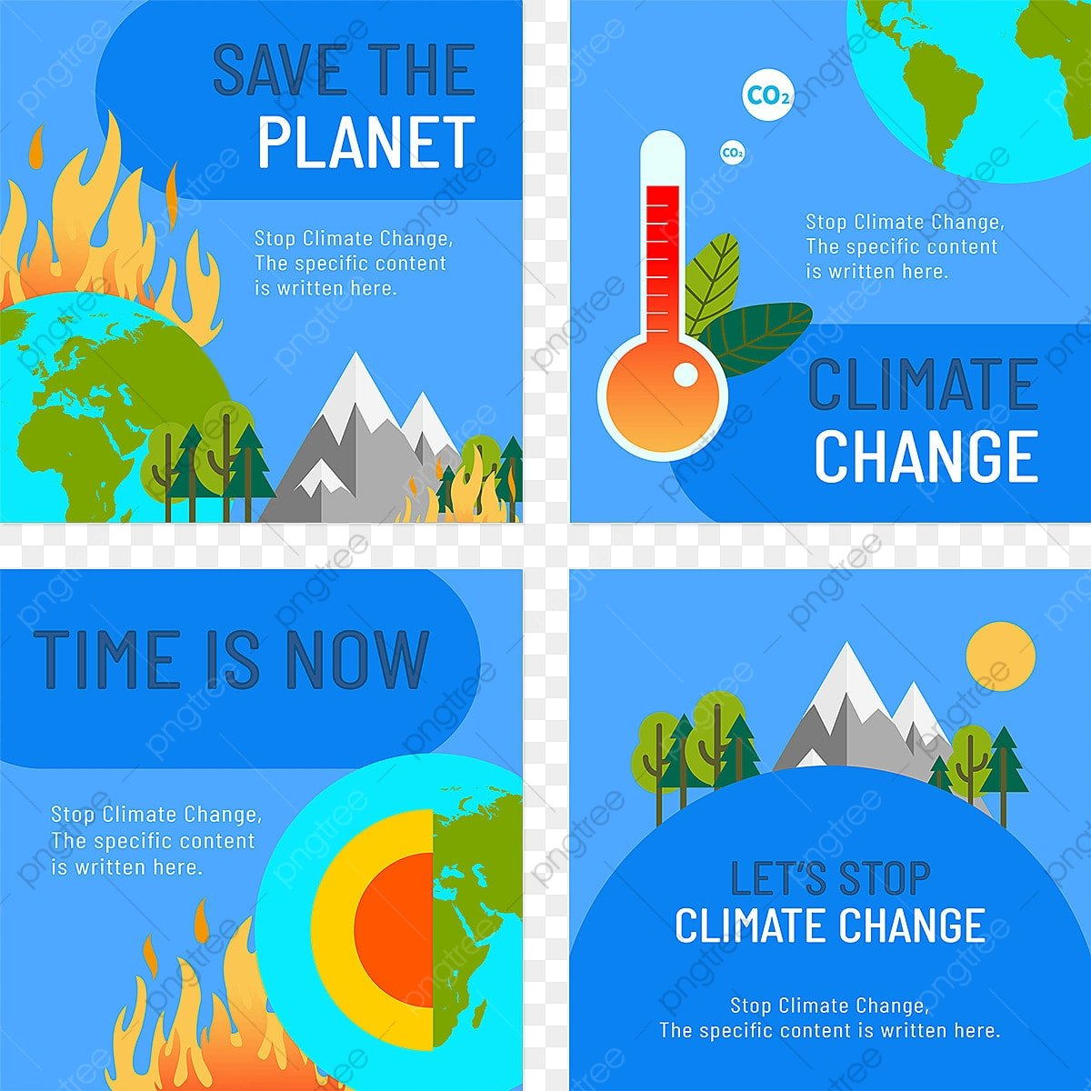

Slide 11
Conclusion
In conclusion, ethics play a pivotal role in creating a more just and sustainable world for all. A collective commitment to ethical decision-making, driven by a sense of responsibility and shared values, is essential to address the ethical imperatives of climate change. By integrating ethics into our individual choices, community practices, and global policies, we can contribute to building a resilient and sustainable future that ensures the well-being of the planet and its inhabitants.

